Slide 1
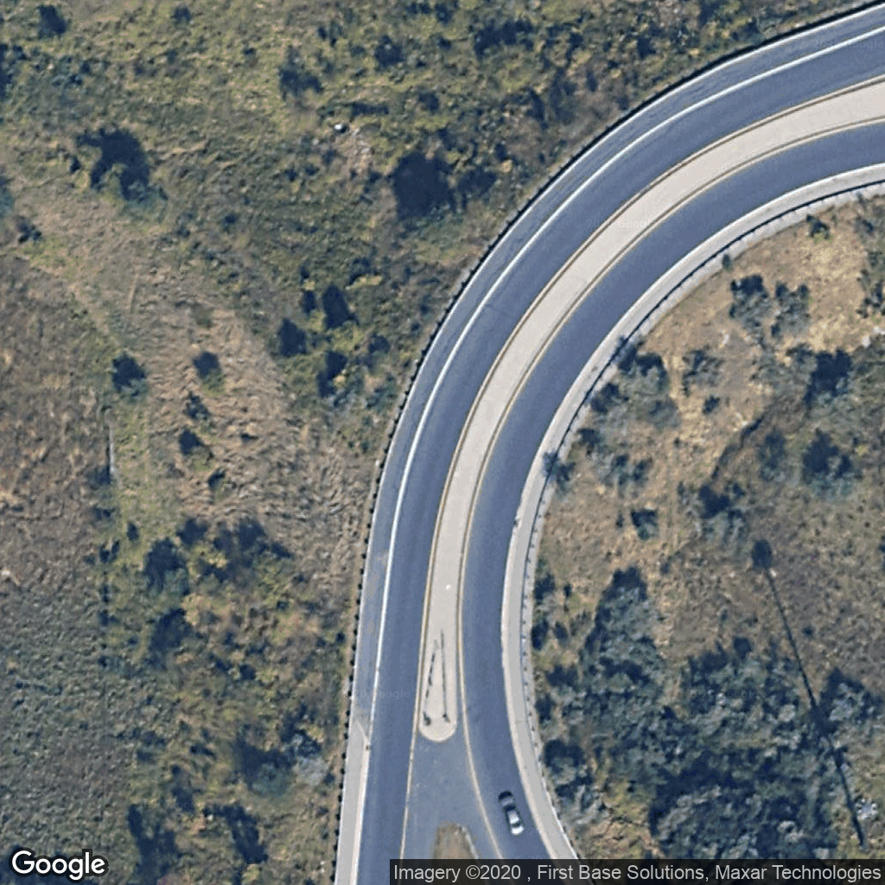
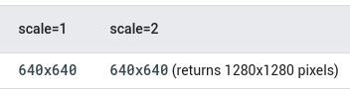
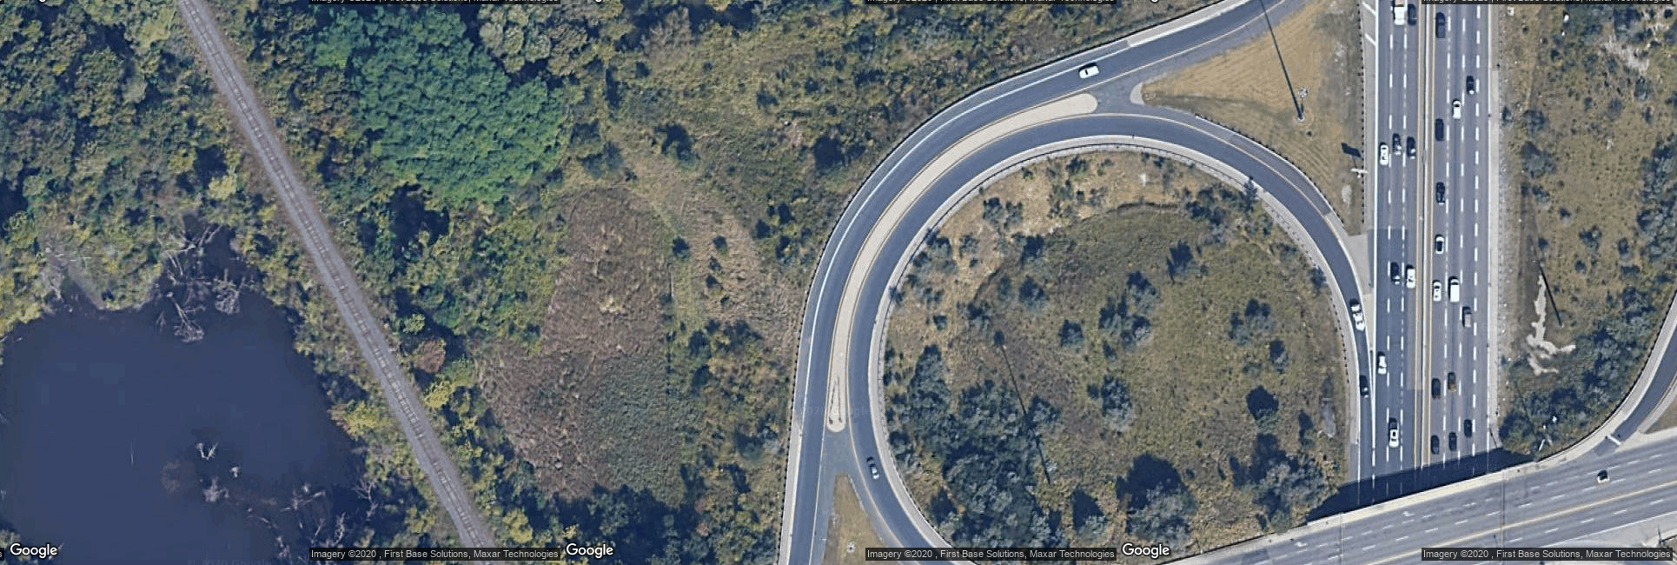
Download large size images
Google static map maximum values:
After concatenation:

Slide 2
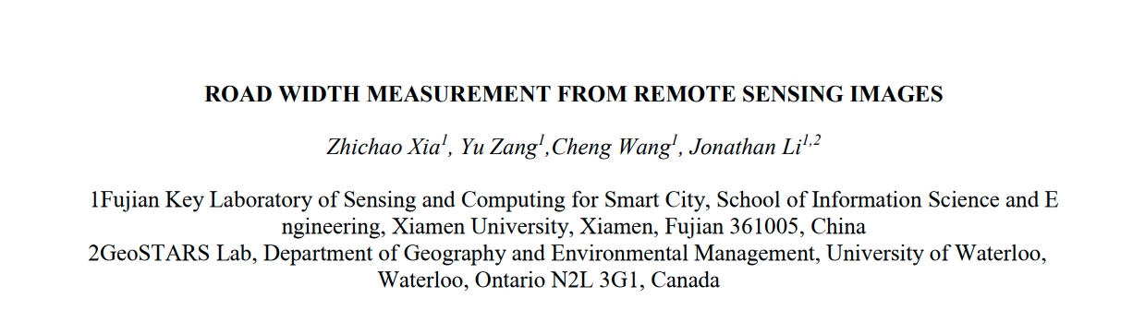
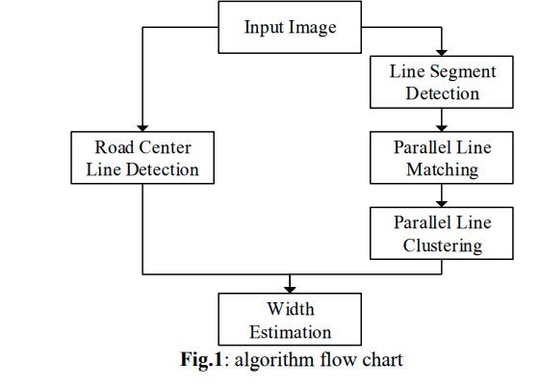
Ref: https://uwaterloo.ca/mobile-sensing/sites/ca.mobile-sensing/files/uploads/files/0000902.pdf

Slide 3
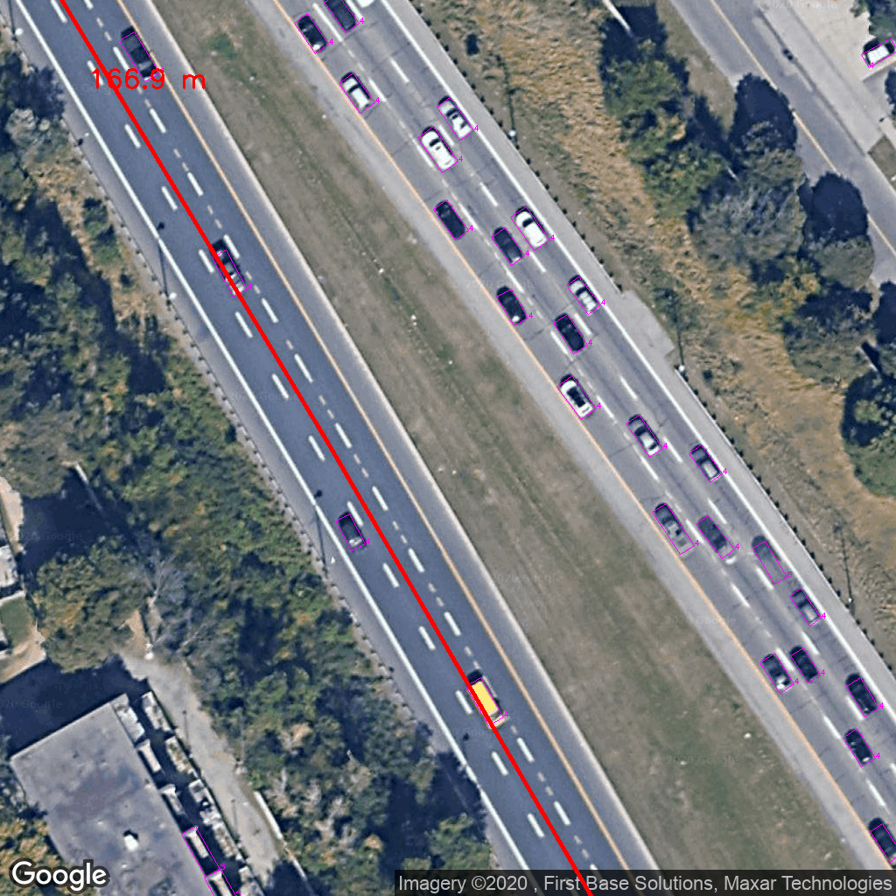
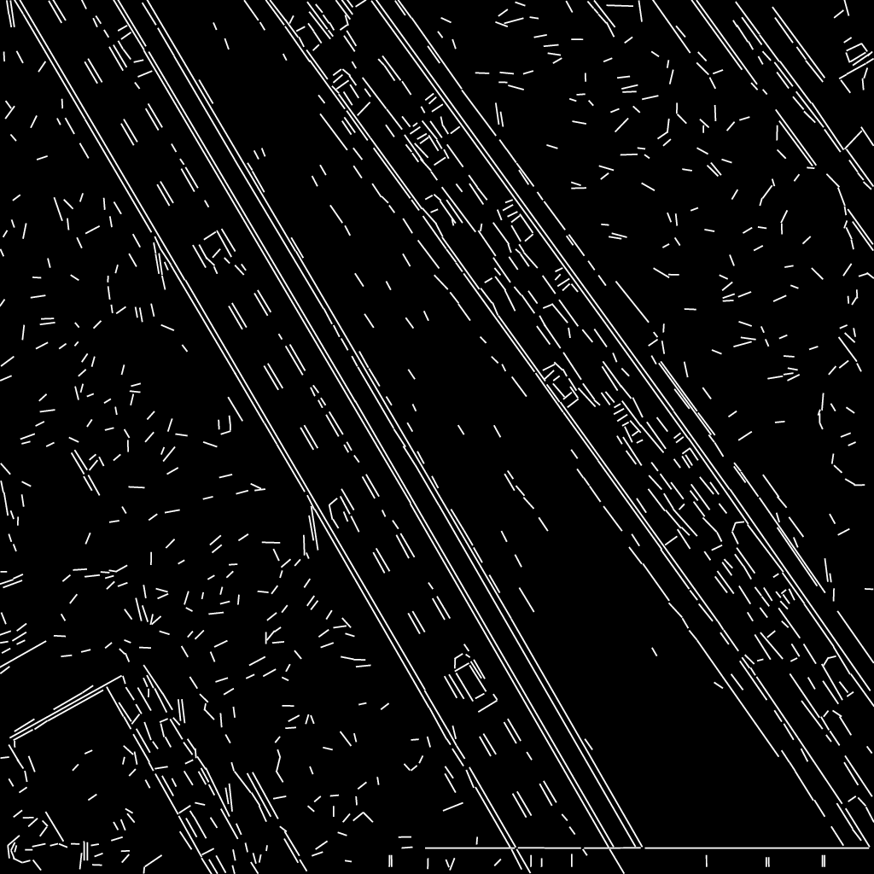
Step 1: Line Segment Detection
Line segment: x1, y1, x2, y2
Ref: https://www.researchgate.net/publication/41910459_LSD_A_Fast_Line_Segment_Detector_with_a_False_Detection_Control

Slide 4
Step 2: select area according to the geospatial data (shapefile)

Slide 5
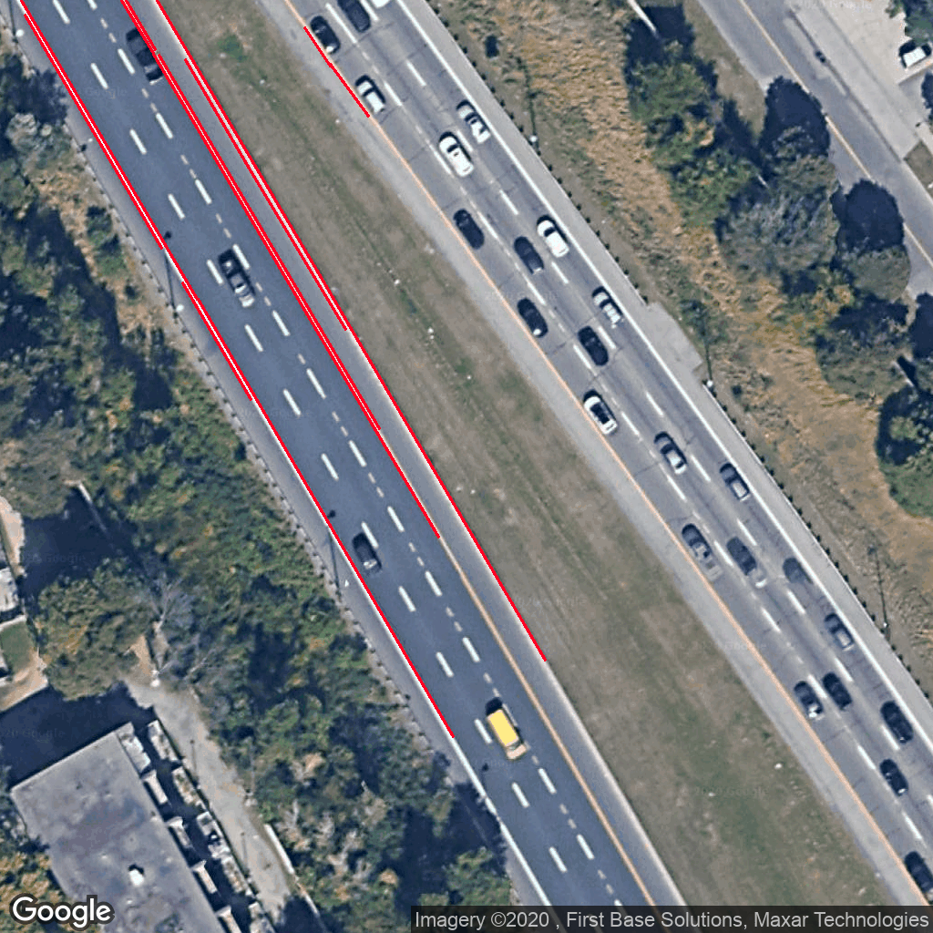
Step 3: filter line segments
1. in selected area
2. length > 5 meters (filter out the short segments on the road)

Slide 6
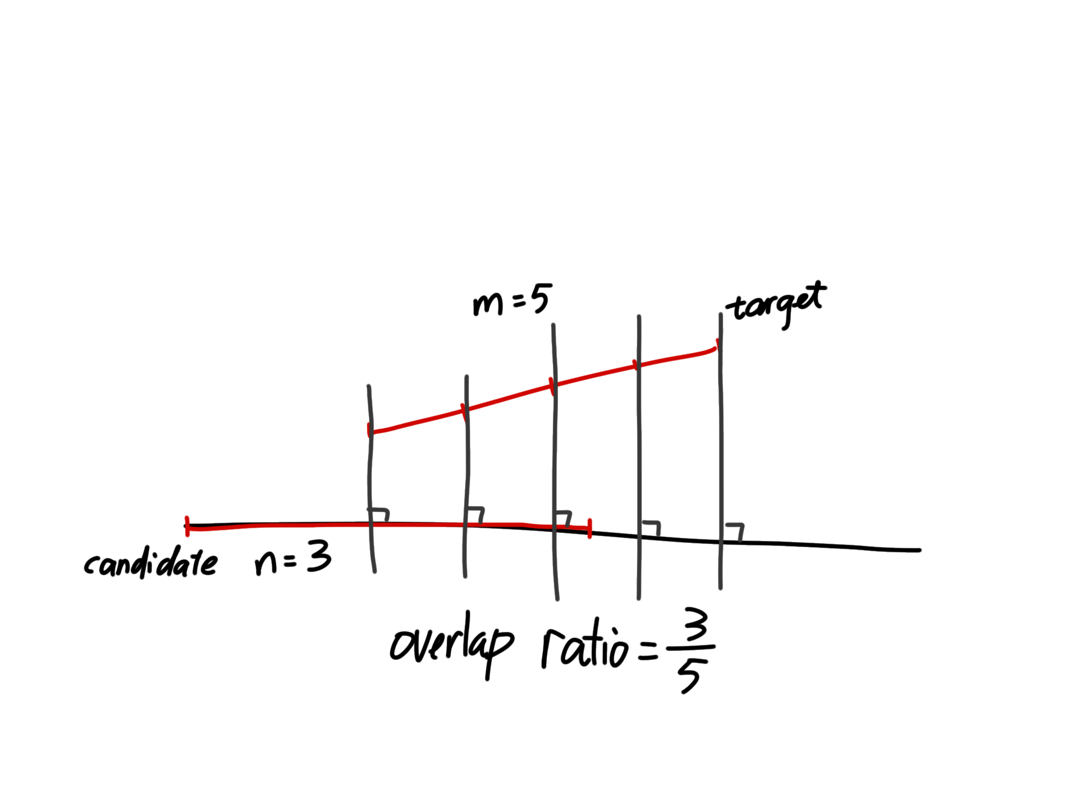
Step 4: find out pairs
Overlap ratio:
1. sample target segment at fixed step, the number of sample points is m
2. draw lines perpendicular to candidate line (where candidate segment located in), over sample point on the target segment
3. count the perpendicular lines across the candidate segment, n
4. overlap ratio is n/m

Slide 7

Step 4: find out pairs

Slide 8
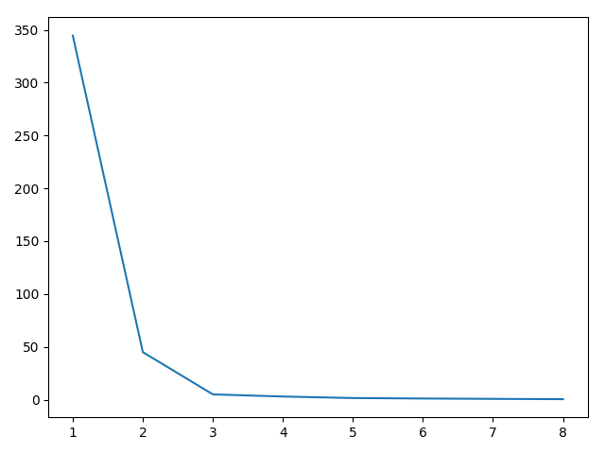
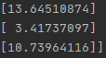
Step 5: k-means clustering
X: The set of the distance between each pair
SSE
elbow
k
1. calculate the SSE for k from 1 to 8
3. k = 3
4. when k=3, cluster centres are
5. road width = 13.6

Slide 9
Step 6 [TODO]: link the segments as a road mask, count the vehicles covered under the mask

